Slide 1
The tradition of Turkey
BY: Sima Hussam G.10
&
Buthaina Kamal G.10
&
Haidy Mahmoud G.10
&
Hassan AL-Omar G.10

Slide 2
INTRODUCTION
Hi here sima, hassan , buthaina , and haidy welcome to our project ,in our project we will talk about TURKEY :
The points that we will talk about:
Culture
Population
Geography
Soccer team
Interesting places
Food

Slide 3
First we have : Interesting places:
The Galata tower
Cappadocia
Hagia Sophia

Slide 4
Interesting places: The Galata tower
It is a medieval stone tower that you can find in Galata quarter of Istanbul.
The top of it is cone shaped.
the tower is nine Stores high, and at the top of the tower you can get a view of the spectacular city of Istanbul and the Bosporus .

Slide 5
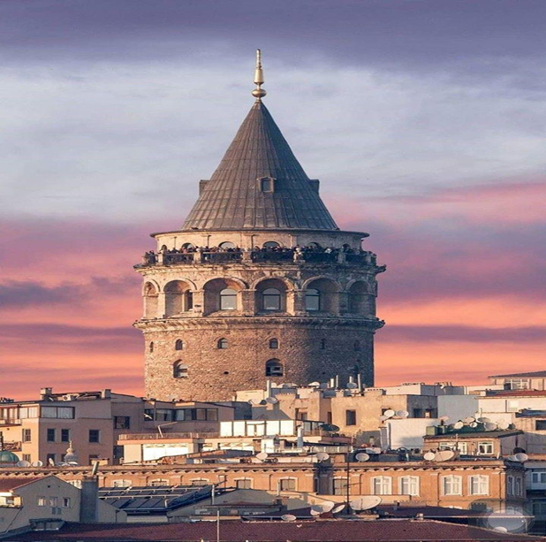
The Galata tower

Slide 6
Cappadocia
Cappadocia is a special place to visit in Turkey because it is a result of volcanic eruption
Explore Cappadocia with a horse ride then take an air balloon ride , it is one of the most beautiful and best cities in Turkey that will leave you in awe of it ..

Slide 7
Cappadocia

Slide 8
Hagia Sophia
The Hagia Sophia is one of the most popular tourist attraction in Turkey it’s an iconic museum.
A church built by emperor Justinian in the 6th century but after 900 years it got converted to a mosque.

Slide 9
Hagia Sophia

Slide 10
Second we have : the population
turkey population 83,783,809.

Slide 11
the population

Slide 12
Third we have: the geography of Turkey
The European side of turkey is mostly a series of rolling hills, while across the Bosporus strait into central Turkey, the land rises into an elevated central plateau (Anatolian), surrounded by (and mixed with) high, rugged mountains, including the Taurus, Koroglu and Pontic ranges.Many peaks in Turkey exceed 10,000 feet, and the tallest, most rugged ones, are found in the Eastern Taurus Mountains. Turkey's highest point is Mt. Ararat which peaks at 16,948 ft. (5,166m),Along the Black Sea and Mediterranean coastlines the land is lower and quite fertile. The Tigras, Kizilirmak, Sakarya and Euphrates are the most significant rivers, and Lake Van is the largest lake.Note: As a geological point-of-interest, the country is positioned on one of the planet's major fault lines, and earthquakes are rather common.

Slide 13
the geography of Turkey

Slide 14
Fourth we have: the Turkish food
Sis kebab
Simit
Turkish coffee and tea
Baklava

Slide 15
Fourth we have the Turkish food Sis kebab
It’s the world most famous sis kebab, and it was born in Turkey if you try it once you will try it million times after. (it is meat perfectly cooked prepared on hot charcoals ).

Slide 16
Sis kebab

Slide 17
Simit
It’s a popular Turkish food or snack to enjoy in the morning , (it is a circular piece of bread topped with sesame seeds , eat the simit with a cup of Turkish tea. .

Slide 18
Simit

Slide 19
Turkish tea and coffee
Tea : is served every where in Turkey , tea is a huge part of the local culture.
Turkish coffee : is very strong and thick in texture . It is similar to the Arabic coffee , Turkish people like to read their fortunes at the end of the drink by the smudges at the bottom of the cup .

Slide 20
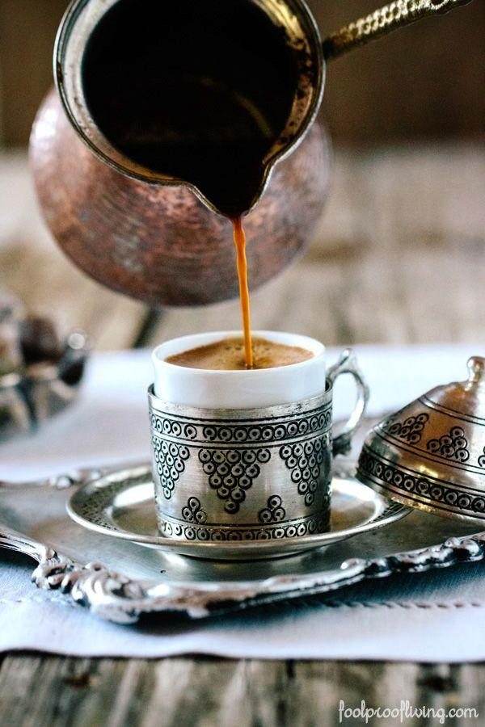
Turkish tea and coffee

Slide 21
Baklava
It is the most popular dessert in the country , it is a sticky sweet filo pastry that consists of several pastry layers , filled with chopped nuts and held neatly in place together with syrup or honey .

Slide 22
Baklava

Slide 23
Fifth we have : the soccer team
•turkey soccer team: Turkey has qualified three times for the FIFA World Cup, in 1950, 1954, and 2002, although they withdrew from the 1950 event. Turkey has also qualified five times for the UEFA European Championship, in 1996, 2000, 2008, 2016, and 2020. They have reached the semi-finals of three major tournaments: the 2002 World Cup, the 2003 FIFA Confederations Cup, and Euro 2008. After their third-place finish at the 2002 World Cup, which marked a high point in Turkish football history, Turkey occupied a spot in the top ten of the FIFA World Rankings for the first time since the rankings were introduced in December 1992.

Slide 24
The soccer team of Turkey

Slide 25
Sixth the culture Turkish culture
Turkeys culture is combination of various cultures like the eastern Mediterranean (west Asia) ,and central Asian region , and Eastern European , and Caucasian traditions , these traditions were initially brought together by the Ottoman Empire , a multi ethnic and multi-religions state .
The tradition of folklore – folktales, jokes legends and the like – in the Turkish language is very rich and is incorporated into everybody life adventures .

Slide 26
Turkish culture

Slide 27
Thank you for your time thanks!!

